Slide 1



Neuro-FleetX: AI-Driven Urban Mobility Optimization
Author: RAGHAVENDRA GADDAM
Created with Pi

Slide 2

CONTENTS
1. Abstract
2. Introduction
3. Objectives
4. Literature Review
5. Technology Stack
6. System Architecture
7. Modules & Features
8. Workflow (How It Works)
9. Future Scope
10. Conclusion

Slide 3

01
Abstract

Slide 4

Abstract
The rapid growth of urban populations has resulted in rising demand for efficient transportation solutions. Traditional fleet management systems are often inefficient, lack predictive intelligence, and fail to integrate AI-driven insights for optimization. Neuro-FleetX is designed as a full-stack urban mobility platform integrating React (frontend), Spring Boot (backend), MySQL (database), JWT authentication (security), and AI/ML algorithms to deliver advanced fleet optimization, real-time tracking, and decision-making support. This project provides a secure, scalable, and intelligent platform to manage fleets, optimize routes, predict demand, and enhance urban mobility. The inclusion of AI/ML modules ensures smarter decisions by leveraging real-time and historical data.

Slide 5

02
Introduction

Slide 6


Introduction
Urban mobility has become a major challenge in modern cities due to:
Congestion and traffic bottlenecks.
Increasing fleet sizes (public, corporate, shared mobility).
Lack of predictive and adaptive systems.
Security and data management concerns.
Neuro-FleetX addresses these issues by combining software engineering best practices with machine learning to create a full-fledged smart mobility platform.

Slide 7

03
Objectives

Slide 8



Objectives
The project is guided by the following objectives:
To design a user-friendly frontend (React + Tailwind) for fleet administrators and users.
To develop a robust backend (Spring Boot) handling APIs, authentication, and business logic.
To implement JWT-based security for secure login and role management.
To use MySQL database for storing user, vehicle, and mobility data.
To integrate AI/ML models for:
To provide real-time dashboards for vehicle tracking and fleet performance.
• Route optimization.
• Demand forecasting.
• Anomaly detection.
To explore the future integration with IoT and cloud deployment for scalability.

Slide 9

04
Literature Review

Slide 10


Literature Review
Existing systems such as Uber, Ola, and other urban mobility platforms provide solutions but often rely on centralized systems without exposing custom APIs for enterprises. Most fleet management software lacks AI-driven predictions and secure, open APIs.
Uber: Focus on ride-sharing but limited enterprise fleet support.
Google Maps APIs: Provide route calculations but not custom AI optimization.
Traditional Fleet Software: Provide only basic tracking and reports.

Slide 11

05
Technology Stack

Slide 12



Technology Stack
Frontend (React + Vite + Tailwind CSS)
Backend (Spring Boot)
Database (MySQL)
• RESTful APIs for communication.
• Tables: Users, Vehicles, Routes, Payments, Logs.
• Provides interactive UI.
• Role-based access.
• Authentication screens, dashboards, analytics.
• Supports relational integrity and scalability.
• Business logic encapsulated in services.
• Lightweight and scalable with reusable components.
Security (JWT Authentication)
AI/ML Algorithms
• Login generates JWT token.
• Route Optimization (Dijkstra/ML models).
• Token used for API authentication.
• Demand Forecasting (Regression/Time Series).
• Prevents unauthorized access.
• Anomaly Detection (Outlier models).

Slide 13

06
System Architecture

Slide 14
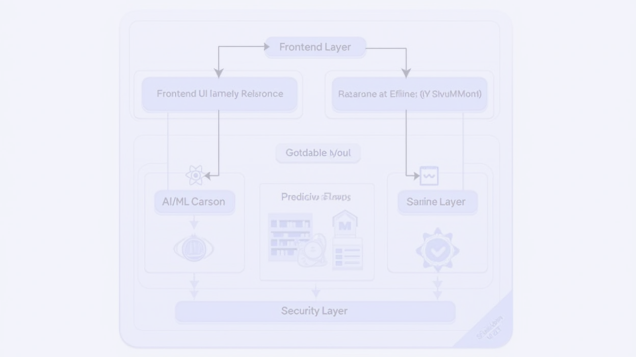

System Architecture
Layers of the system:
Frontend Layer (React UI) → User dashboards, login, reports.
Backend Layer (Spring Boot) → APIs, services, controllers.
Database Layer (MySQL) → Persistent data storage.
AI/ML Layer → Predictive models and analytics.
Security Layer → JWT authentication flow.

Slide 15

07
Modules & Features

Slide 16


Modules & Features
User Authentication & Role Management:
Vehicle & Fleet Management:
• JWT login/signup.
• Register vehicles.
• Role-based access (Admin, Driver, User).
• Assign drivers.
• Fleet dashboards.
AI/ML Modules:
Database Management:
• Route optimization algorithms.
• Storing trips, payments, logs.
• Predicting high-demand areas.
• Query optimization.
• Detecting unusual driving/maintenance needs.
Admin Panel:
• Monitor real-time fleet.
• Analyze performance reports.

Slide 17
08
Workflow (How It Works)

Slide 18


Workflow (How It Works)
User Login: User authenticates → JWT token generated.
API Request: Token used in headers for backend communication.
Backend Processing: Spring Boot validates token, processes request.
Database Interaction: Data retrieved from MySQL.
AI Integration: For route/demand predictions.
Frontend Update: React UI displays results dynamically.

Slide 19
09
Future Scope

Slide 20
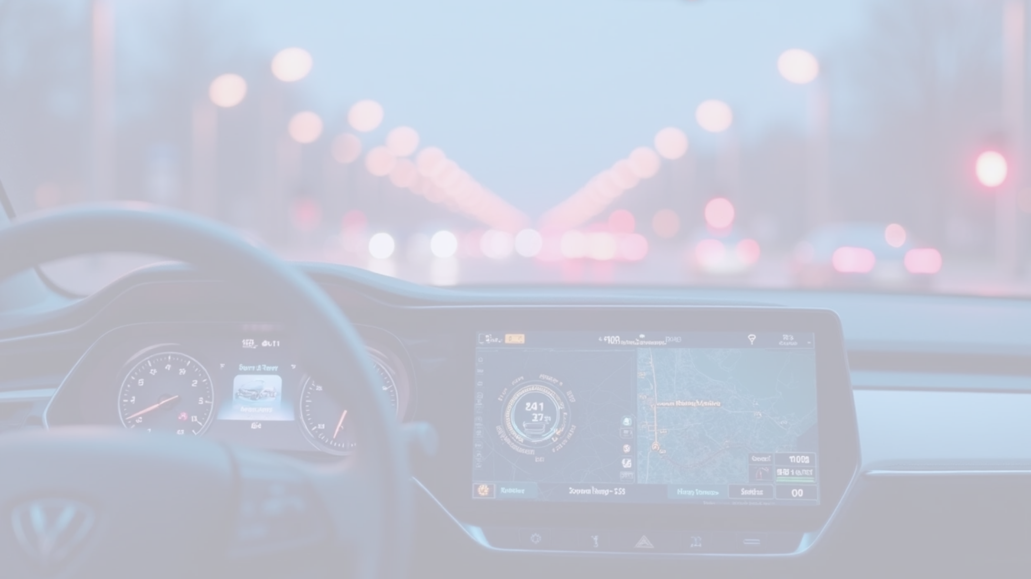


Future Scope
IoT Integration
AI Expansion
Blockchain
GPS sensors, vehicle health monitoring.
Deep learning for traffic prediction.
For secure payments and contracts.
Cloud Deployment
Mobile App Version
Docker + Kubernetes for scaling.
Flutter/React Native-based mobile app.

Slide 21

10
Conclusion

Slide 22

Conclusion
Neuro-FleetX successfully demonstrates the design of a full-stack, AI-powered mobility platform. The integration of React, Spring Boot, MySQL, JWT, and ML ensures a secure, scalable, and intelligent system for urban mobility challenges. This project can serve as the foundation for real-world smart city fleet management applications.

Slide 23

Thank You

